Slide 1

Model Creation in Azure AutoML and Ingestion via VBA

Slide 2

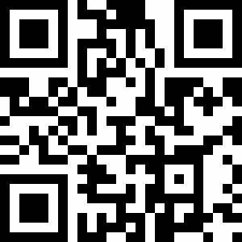




Who am I
A Machine Learning Developer for Purple Frog Systems based in the UK
Certified Microsoft Data Scientist Associate
5 years experience working with data primarily through R,VBA and Python, while only recently introduced to the Microsoft stack when he moved to Purple Frog Systems
Lewis Prince | LinkedIn
Lewis Prince (@lewis_prince) / Twitter
Lewis@PurpleFrogSystems.com

Slide 3

Contents
Goals
What is Machine Learning?
What is AutoML?
Explain what machine learning is
Demo
Who should use it?
What problems can it solve?
Explain what AutoML is
Common workflow
Demo
Questions
Demo
Understand how we can use the models we create

Slide 4





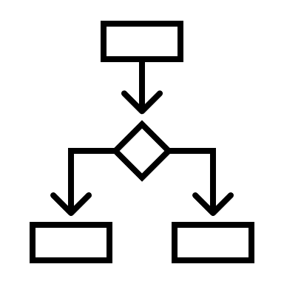

What is Machine Learning?
‘Study of computer algorithms that can improve automatically through experience and using data’
Notes:
Machine learning learns and predicts on passive data, while AI implies an agent interacting with the environment to learn and take actions that maximizes its chance of completing its goals.
Was once one and the same with AI, but is now argued whether it is a branch of AI or its own separate field

Slide 5

What is AutoML?
Automated Machine Learning
Time Saving Tool via automating the time-consuming, iterative tasks of machine learning model development
Tries many different combinations of algorithm, hyperparameters and pre-processing

Slide 6

Demo
Run through of Azure ML studio

Slide 7

Who should use it?
Everyone and Anyone
Newbies:
Great access point, requires no/relatively low coding or ML knowledge
Learning tool; can ‘see under the hood’
Allows access to ML solutions for all
Experienced:
Time saver
Introduction to new algorithms
Can be used via code through VS code extensions

Slide 8

What problems can it solve?
Currently:
Classification – yes or no to a loan
Time Series – forecasting oil prices
Regression – predicting store sales
Additionally in preview:
Natural Language Processing – classifying a movie script as romantic
Computer vision – Identifying a dog in an image
These two require a GPU compute instance/cluster though due to the computation needed

Slide 9
Demo
Ingest Data and Set Up
Running and understanding output
VS Code example

Slide 10
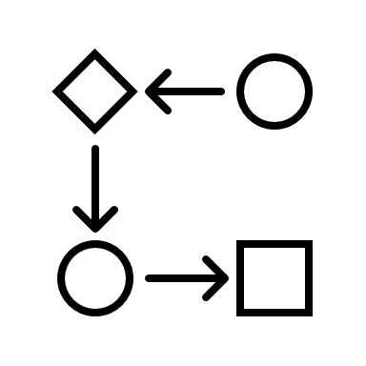
Common Workflow
Question is asked
Scan the data
Generate features
Preprocess
Experiment with Algorithms
Test Final Model
Put into production
Continuous testing

Slide 11
Demo
Using output in excel

Slide 12
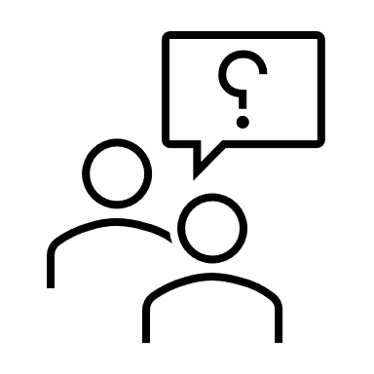
Questions
Lewis Prince | LinkedIn
Lewis Prince (@lewis_prince) / Twitter
Lewis@PurpleFrogSystems.com

Slide 13
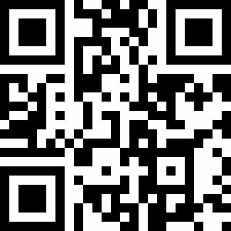
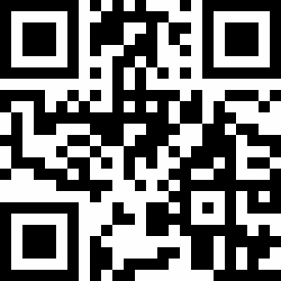
Further Reading
AutoML; How to use it and why | Purple Frog Systems
Deploy Azure AutoML Model And Consume In Excel | Purple Frog Systems

